Slide 1
Bat algorithm

Slide 2
Outline
1- Introduction to the Bat Algorithm
2- Understanding Echolocation
3- The Fundamentals of Bat Algorithm
4- Mathematical Modeling of Bat Algorithm
5- Applications of the Bat Algorithm
6- Advantages of the Bat Algorithm
7- Use case example
8-Latest Research Updates on the Bat Algorithm
9-Conclusion

Slide 3
1. Introduction to the Bat Algorithm

Slide 4
What is bat algorithm
-Metaheuristic Algorithms: Metaheuristic algorithms are high-level problem-independent algorithmic frameworks that provide a set of guidelines or strategies to develop heuristic optimization algorithms. They are widely used to solve complex optimization problems that are tough for traditional methods.
-Inspired from Nature: The Bat Algorithm is inspired by the echolocation behavior of microbats. These bats emit sound waves to detect and locate prey and obstacles.
-Inventor and Year: Developed by Xin-She Yang in 2010, the algorithm mimics the varying pulse rates of emission and loudness of bats.

Slide 5

Who is Xin-She Yang :
Xin-She Yang is a Reader at Middlesex University and was a senior research scientist at the National Physical Laboratory, best known as a developer of various heuristic algorithms for engineering optimization. He obtained a DPhil in applied mathematics from Oxford University.

Slide 6
2- Understanding Echolocation

Slide 7
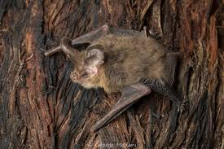
What is a Microbat
-Microbats are tiny flying mammals. There are more than 60 different types of Microbats. The smallest microbat weighs only 3 grams, the largest is the carnivorous ghost bat (Macroderma gigas) which weighs just 150 grams.
-The microbats are usually small, eat insects, and use echolocation to find their way in the dark

Slide 8
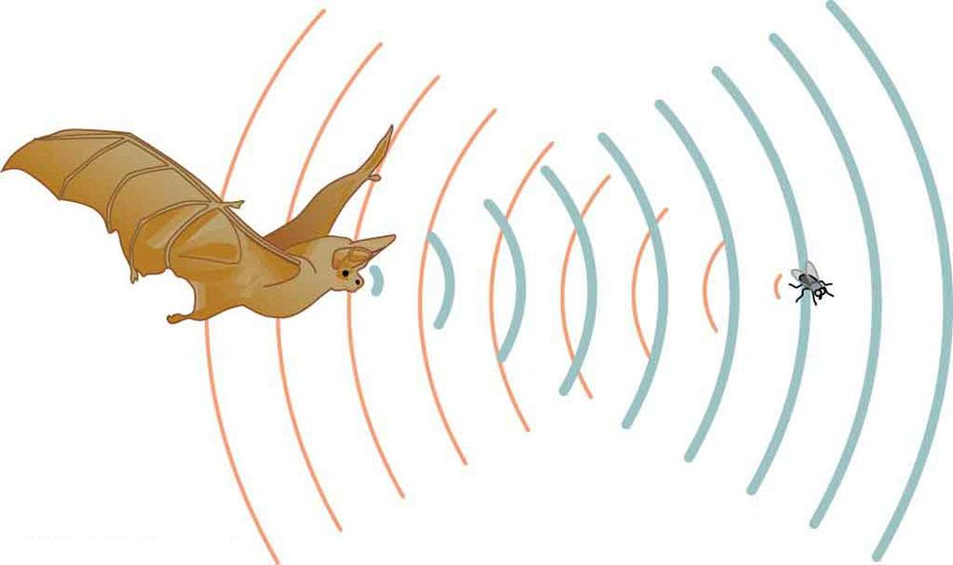
Echolocation : Microbats use echolocation to navigate and hunt in the dark, emitting sound waves that bounce back from objects, allowing them to "see" in the dark.

Slide 9
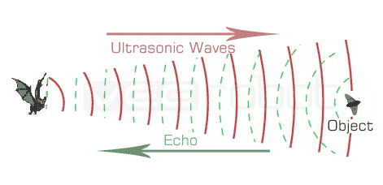
Biological Mechanism: The bat emits a sound and listens to the echoes returned, which helps it to map out the environment and locate objects and prey.

Slide 10
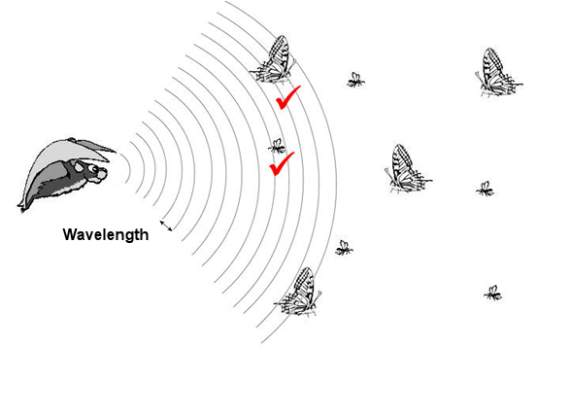
From these echoes, the bats can determine the size of objects, distance, and how fast they are traveling.

Slide 11

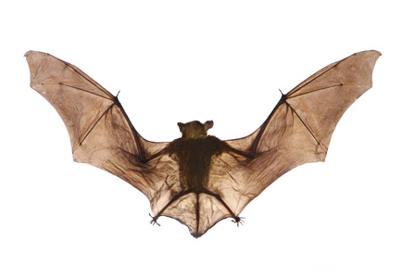

Slide 12
3- The Fundamentals of Bat Algorithm

Slide 13
This bat algorithm is based on the echolocation behavior of microbats with varying pulse rates of emission and loudness

Slide 14
Algorithm Parameters
The Bat Algorithm uses frequency, velocity, loudness, and pulse rate to simulate bat movement and behavior :
- velocity “vi”
- position “Xi”
- fixed frequency “f”
- varying pulse “λ”
- loudness “A”
They can automatically adjust the wavelength (or frequency) of their emitted pulses and adjust the rate of pulse emission “r” in the range of [0, 1], depending on the proximity of their target.

Slide 15
velocity
Pulse
position
loudness
frequency

Slide 16
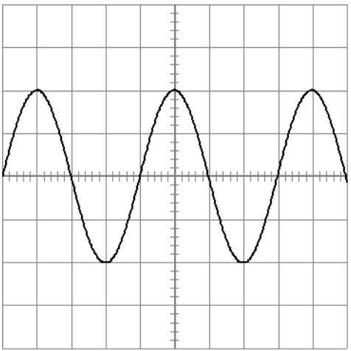
frequency “f”: Number of waves that pass a fixed point in unit time.
Wave

Slide 17

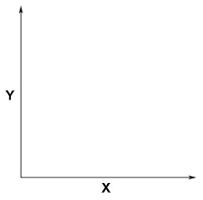
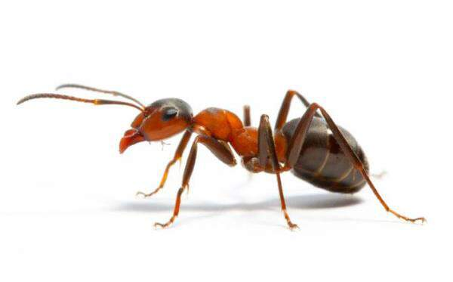
position “X”: Location of the bats

Slide 18
velocity “v” : speed of something in a given direction

Slide 19
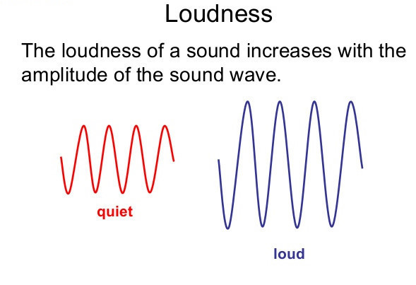
loudness “A” : characteristics of sound, it refers to how loud or soft a sound seems to the listener and it is determined by the intensity of the sound waves

Slide 20
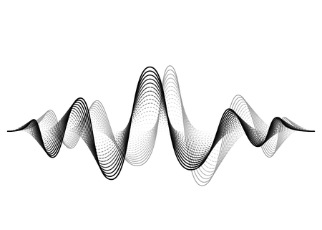
Pulse “λ” : refers to a wave or vibration

Slide 21
Pseudocode
1-Initialize bat population, position, velocity, frequency, and loudness.
2-While (termination condition not met):
Generate new solutions by adjusting frequency and updating velocities and positions.
If (random number > loudness) then select a local solution around the best solution.
Generate a random solution around the best solution.
Update loudness and pulse rate.
3-Rank bats and identify the best solution.

Slide 22
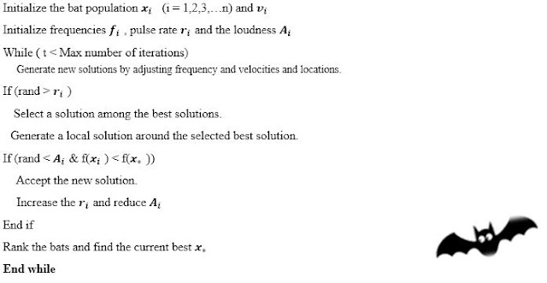

Slide 23
NO
initialize the bat population and vi
Define pulse frequency fi at xi
Initialize pulse rates ri and the loudness Ai
^{t} ^{<MAXt}
Generate new solutions by adjusting frequency f,
^{Update xi,vi}
^{Rand>ri}
NO
^{Rand<Ai}
^{& F(xi)<f(x*)}
Generate a new solution by flying randomly
Generate a local solution around the selected best solution
Select a solution among the best solutions
NO
Postprocess results and visualization
^{Accept the new solutions}
^{Increase ri}
^{reduce Ai}
Rank the bats and find the current best x∗

Slide 24

NO
initialize the bat population and vi
Define pulse frequency fi at xi
Initialize pulse rates ri and the loudness Ai
^{t} ^{<MAXt}
Generate new solutions by adjusting frequency f,
^{Update xi,vi}
^{Rand>ri}
NO
^{Rand<Ai}
^{& F(xi)<f(x*)}
Generate a new solution by flying randomly
Generate a local solution around the selected best solution
Select a solution among the best solutions
NO
Postprocess results and visualization
^{Accept the new solutions}
^{Increase ri}
^{reduce Ai}
Rank the bats and find the current best x∗

Slide 25


NO
initialize the bat population and vi
Define pulse frequency fi at xi
Initialize pulse rates ri and the loudness Ai
^{t} ^{<MAXt}
Generate new solutions by adjusting frequency f,
^{Update xi,vi}
^{Rand>ri}
NO
^{Rand<Ai}
^{& F(xi)<f(x*)}
Generate a new solution by flying randomly
Generate a local solution around the selected best solution
Select a solution among the best solutions
NO
Postprocess results and visualization
^{Accept the new solutions}
^{Increase ri}
^{reduce Ai}
Rank the bats and find the current best x∗

Slide 26
NO
initialize the bat population and vi
Define pulse frequency fi at xi
Initialize pulse rates ri and the loudness Ai
^{t} ^{<MAXt}
Generate new solutions by adjusting frequency f,
^{Update xi,vi}
^{Rand>ri}
NO
^{Rand<Ai}
^{& F(xi)<f(x*)}
Generate a new solution by flying randomly
Generate a local solution around the selected best solution
Select a solution among the best solutions
NO
Postprocess results and visualization
^{Accept the new solutions}
^{Increase ri}
^{reduce Ai}
Rank the bats and find the current best x∗

Slide 27
4- Mathematical Modeling of Bat Algorithm

Slide 28
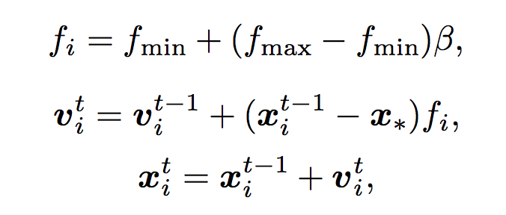



Equation used
1
2
3
4
5
6

Slide 29
5- Applications of the Bat Algorithm

Slide 30
Example
Assume that
F min=0
F max =10

Slide 31
f = 2
x = 4
v = 3
A = 1
r = 0
1
Goal
f = 6
x = 8
v = 7
A = 0,8
r = 0.2
2
f = 3
x = 5
v = 4
A = 0,9
r = 0.1
3

Slide 32
Initialize
t=1
t=2
t=3
f =
x =
v =
A =
r =
1
f =
x =
v =
A =
r =
2
f =
x =
v =
A =
r =
3

Slide 33
Initialize (random)
t=1
t=2
t=3
f = 2
x =
v =
A = 1
r = 0
1
f = 6
x =
v =
A = 0,8
r = 0.2
2
f = 3
x =
v =
A = 0,9
r = 0.1
3

Slide 34
Initialize (random)
t=1
t=2
t=3
f = 2
x = 4
v = 3
A = 1
r = 0
1
f = 6
x = 8
v = 7
A = 0,8
r = 0.2
2
f = 3
x = 5
v = 4
A = 0,9
r = 0.1
3

Slide 35
Initialize (random)
t=1
t=2
t=3
f = 2
x = 4
v = 3
A = 1
r = 0
f = 8
x =
v =
A = 1
r = 0
1
1
f = 6
x = 8
v = 7
A = 0,8
r = 0.2
f = 3
x =
v =
A = 0.8
r = 0.2
2
2
f = 3
x = 5
v = 4
A = 0,9
r = 0.1
f = 4
x =
v =
A = 0.9
r = 0.1
3
3

Slide 36
Initialize (random)
t=1
t=2
t=3
f = 2
x = 4
v = 3
A = 1
r = 0
f = 8
x = 39
v = 35
A = 1
r = 0
1
1
f = 6
x = 8
v = 7
A = 0,8
r = 0.2
f = 3
x =
v =
A = 0.8
r = 0.2
2
2
f = 3
x = 5
v = 4
A = 0,9
r = 0.1
f = 4
x =
v =
A = 0.9
r = 0.1
3
3

Slide 37
Initialize (random)
t=1
t=2
t=3
f = 2
x = 4
v = 3
A = 1
r = 0
f = 8
x = 39
v = 35
A = 1
r = 0
1
1
= 3 + (4-0) * 8 = 35
f = 6
x = 8
v = 7
A = 0,8
r = 0.2
f = 3
x =
v =
A = 0.8
r = 0.2
2
2
f = 3
x = 5
v = 4
A = 0,9
r = 0.1
f = 4
x =
v =
A = 0.9
r = 0.1
3
3

Slide 38
Initialize (random)
t=1
t=2
t=3
f = 2
x = 4
v = 3
A = 1
r = 0
f = 8
x = 39
v = 35
A = 1
r = 0
1
1
= 4 + 35 = 39
f = 6
x = 8
v = 7
A = 0,8
r = 0.2
f = 3
x =
v =
A = 0.8
r = 0.2
2
2
f = 3
x = 5
v = 4
A = 0,9
r = 0.1
f = 4
x =
v =
A = 0.9
r = 0.1
3
3

Slide 39
Initialize (random)
t=1
t=2
t=3
f = 2
x = 4
v = 3
A = 1
r = 0
f = 8
x = 39
v = 35
A = 1
r = 0
1
1
f = 6
x = 8
v = 7
A = 0,8
r = 0.2
f = 7
x = 71
v = 63
A = 0.8
r = 0.2
2
2
f = 3
x = 5
v = 4
A = 0,9
r = 0.1
f = 5
x = 34
v = 29
A = 0.9
r = 0.1
3
3

Slide 40
Initialize (random)
t=1
t=2
t=3
f = 2
x = 4
v = 3
A = 1
r = 0
f = 8
x = 39
v = 35
A = 1
r = 0
1
1
f = 6
x = 8
v = 7
A = 0,8
r = 0.2
f = 7
x = 71
v = 63
A = 0.8
r = 0.2
2
2
f = 3
x = 5
v = 4
A = 0,9
r = 0.1
f = 5
x = 34
v = 29
A = 0.9
r = 0.1
3
3

Slide 41
Initialize (random)
t=1
t=2
t=3
Random = 0.5
f = 2
x = 4
v = 3
A = 1
r = 0
f = 8
x = 39
v = 35
A = 1
r = 0
1
1
f = 6
x = 8
v = 7
A = 0,8
r = 0.2
f = 7
x = 71
v = 63
A = 0.8
r = 0.2
2
2
f = 3
x = 5
v = 4
A = 0,9
r = 0.1
f = 5
x = 34
v = 29
A = 0.9
r = 0.1
3
3

Slide 42
Initialize (random)
t=1
t=2
t=3
Random = 0.5
f = 2
x = 4
v = 3
A = 1
r = 0
f = 8
x = 39
v = 35
A = 1
r = 0
1
1
Compare
f = 6
x = 8
v = 7
A = 0,8
r = 0.2
f = 7
x = 71
v = 63
A = 0.8
r = 0.2
2
2
f = 3
x = 5
v = 4
A = 0,9
r = 0.1
f = 5
x = 34
v = 29
A = 0.9
r = 0.1
3
3

Slide 43
Initialize (random)
t=1
t=2
t=3
Random = 0.5
BEST
f = 8
x = 39
v = 36
A = 1
r = 0.4
f = 2
x = 4
v = 3
A = 1
r = 0
f = 8
x = 39
v = 35
A = 1
r = 0
1
4
1
f = 6
x = 8
v = 7
A = 0,8
r = 0.2
f = 7
x = 71
v = 63
A = 0.8
r = 0.2
2
2
f = 3
x = 5
v = 4
A = 0,9
r = 0.1
f = 5
x = 34
v = 29
A = 0.9
r = 0.1
3
3

Slide 44

Initialize (random)
t=1
t=2
t=3
Random = 0.2
f = 8
x = 39
v = 35
A = 1
r = 0
f = 8
x = 39
v = 36
A = 1
r = 0
f = 2
x = 4
v = 3
A = 1
r = 0
1
4
1
f = 6
x = 8
v = 7
A = 0,8
r = 0.2
f = 7
x = 71
v = 63
A = 0.8
r = 0.2
2
2
f = 3
x = 5
v = 4
A = 0,9
r = 0.1
f = 5
x = 34
v = 29
A = 0.9
r = 0.1
3
3

Slide 45
Initialize (random)
t=1
t=2
t=3
Random = 0.5
f = 8
x = 39
v = 35
A = 1
r = 0
f = 8
x = 39
v = 36
A = 1
r = 0
f = 2
x = 4
v = 3
A = 1
r = 0
1
4
1
f = 6
x = 8
v = 7
A = 0,8
r = 0.2
f = 7
x = 71
v = 63
A = 0.8
r = 0.2
2
2
f = 3
x = 5
v = 4
A = 0,9
r = 0.1
f = 5
x = 34
v = 29
A = 0.9
r = 0.1
3
3

Slide 46
Initialize (random)
t=1
t=2
t=3
Random = 0.5
f = 8
x = 39
v = 35
A = 1
r = 0
F(x)=0.2
f = 8
x = 39
v = 36
A = 1
r = 0
F(x)=0.2
f = 2
x = 4
v = 3
A = 1
r = 0
1
4
1
f = 6
x = 8
v = 7
A = 0,8
r = 0.2
f = 7
x = 71
v = 63
A = 0.8
r = 0.2
F(x)=0.3
Assume f(x*)= 4
2
2
Acceptance criteria:
Rand< Ai & F(xi) < f(x*)
f = 3
x = 5
v = 4
A = 0,9
r = 0.1
3

Slide 47
Initialize (random)
t=1
t=2
t=3
Random = 0.5
f = 8
x = 39
v = 35
A = 0.9
r = 0.1
F(x)=0.2
f = 8
x = 39
v = 36
A = 0.9
r = 0.5
F(x)=0.2
f = 2
x = 4
v = 3
A = 1
r = 0
1
4
1
f = 6
x = 8
v = 7
A = 0,8
r = 0.2
f = 7
x = 71
v = 63
A = 0.7
r = 0.4
F(x)=0.3
Assume f(x*)= 4
2
2
Acceptance criteria:
Rand< Ai & F(xi) < f(x*)
f = 3
x = 5
v = 4
A = 0,9
r = 0.1
3

Slide 48
Initialize (random)
t=1
t=2
t=3
Random = 0.5
f = 7
x = 35
v = 31
A = 0.9
r = 0.1
F(x)=0.2
f = 8
x = 39
v = 36
A = 0.9
r = 0.5
F(x)=0.2
f = 2
x = 4
v = 3
A = 1
r = 0
1
4
1
f = 6
x = 8
v = 7
A = 0,8
r = 0.2
f = 7
x = 71
v = 63
A = 0.7
r = 0.4
F(x)=0.3
Assume f(x*)= 4
2
2
Acceptance criteria:
Rand< Ai & F(xi) < f(x*)
Select best X*
X*=1
f = 3
x = 5
v = 4
A = 0,9
r = 0.1
3

Slide 49
6- Advantages of the Bat Algorithm

Slide 50
Performance Comparison
Speed
-GA(Genetic Algorithm): Generally slower due to complex genetic operations.
-PSO(Particle Swarm Optimization): Faster due to simpler calculations.
-BA(Bat Algorithm): Comparable to PSO, often faster than GA due to efficient convergence mechanisms.
Accuracy
-GA: High accuracy, requires parameter tuning and larger populations.
-PSO: Good accuracy, prone to premature convergence.
-BA: Balances exploration and exploitation well, achieving high accuracy in multimodal landscapes.
Robustness
-GA: Highly robust, maintains genetic diversity.
-PSO: Robust but can suffer from premature convergence.
-BA: Excellent in dynamic and noisy environments and adapts quickly to changes.

Slide 51
Advantages of the Bat Algorithm
Dynamic Landscapes: Quickly adapts to changes, making it effective for evolving problem spaces.
Complex Problem Solving: Navigates complex solutions with many local optima effectively.
Flexibility and Simplicity: Easy to tune parameters, adaptable to various problem types.
Scalability: Maintains performance efficiently as problem size and complexity increase.

Slide 52
7-Use case

Slide 53
Optimizing Solar Panel Layout
Problem Description :
In a solar farm, the arrangement and orientation of solar panels significantly affect their efficiency and total energy output. Factors such as the angle of tilt, the direction of panels relative to the sun, and the spacing between panels to avoid shading can all influence performance. The Bat Algorithm can be employed to find the optimal configuration that maximizes the total energy output of the solar farm.
Business Use Case :
For businesses involved in solar energy, especially those managing large solar farms, this algorithm can optimize the layout and angling of solar panels to maximize sunlight capture throughout the day. By automating the optimization process, the script reduces the need for manual calculations and adjustments, ensuring that the solar panels operate at peak efficiency. Improved energy output translates directly to higher profitability and faster return on investment, making this a valuable tool for strategic decision-making in renewable energy operations.

Slide 54
variables:
- pop_size: The number of candidate solutions in the population
- max_iterations: The maximum number of iterations the algorithm runs
-loudness and pluse_rate: Parameters specific to the Bat Algorithm that affect its exploration behavior in the search space
-panel_count: The number of solar panels in the array, each requiring optimization of its position and orientation.
Functions:
-initialize_bats(population, nb_of_panels) : Initializes the bat population with random values for position, orientation, and tilt.
-update_position(bat, velocity, nb_of_panels) : Updates the position of each bat based on its velocity
-objective_function(bats, nb_of_panels) : Calculates the fitness of each bat by evaluating how closely the tilt and orientation of each panel align with optimal values
-bat_algorithm(...) : Implements the main loop of the Bat Algorithm and tracks the best solution found and its fitness across iterations.
-save_panel_configuration_to_csv(solution, panel_count) and save_positions_to_csv(position_history, panel_count) : These functions output the best panel configuration and the history of configurations to CSV files, useful for analysis and reporting.
-create_pdf_report(...) : Generates a comprehensive PDF report

Slide 55
8-Latest Research Updates on the Bat Algorithm

Slide 56
Hybridization Techniques: Enhancing optimization through hybrid models combining the Bat Algorithm with other evolutionary algorithms for superior performance.
Adaptive Mechanisms: Incorporating real-time adaptive adjustments to the algorithm’s parameters, improving efficiency in dynamic environments.
Applications in New Domains: Expanding the Bat Algorithm's applications into cutting-edge fields like neural networks, drone navigation, and network security.
Performance Enhancements: Algorithmic modifications aimed at speeding up convergence and increasing the robustness of solutions.
Comparative Studies: Benchmarking the Bat Algorithm against contemporary methods to highlight its strengths and areas for improvement across various performance metrics.

Slide 57
9-Conclusion

Slide 58
The Bat Algorithm, inspired by the natural echolocation of bats, has proven to be a versatile and efficient tool for complex optimization challenges. Its ability to adapt dynamically to changing environments makes it superior to traditional methods like Genetic Algorithms and Particle Swarm Optimization.
thank you for your attention and feel free to express your opinion about this algorithm !!
git hub link :
https://github.com/medaminemachfar/bat-algo.git

Slide 59
Thanks

